Slide 1
Area of Triangles
Year 7
Week 6
Lesson 2

Slide 2
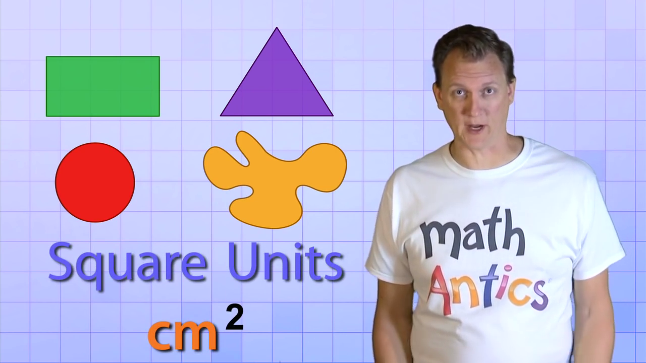
Beginning of the Lesson
Notes:
• Link to past experiences or knowledge of the students
• Actively involve the students
• Relevant to the objective of the upcoming lesson

Slide 3


Lesson Objectives
How to work out the area of a triangle
Notes:
• Share with students what they are learning or will be able to do
• Why the lesson is important

Slide 4
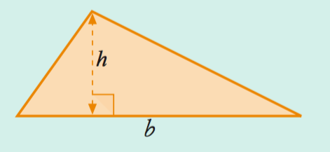
24
7
30
Topic: Area of a Triangle
Date
EQ – How do we calculate the area of a triangle?
Area = ½ (b x h)

Slide 5
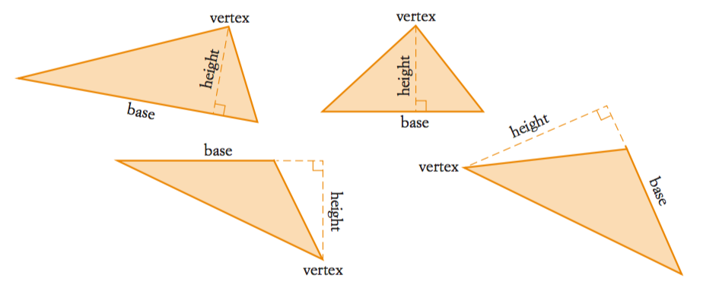
24
7
30
Topic: Area of a Triangle
Date
EQ – How do we calculate the area of a triangle?
Remember: Triangles comes in all shapes and sizes

Slide 6
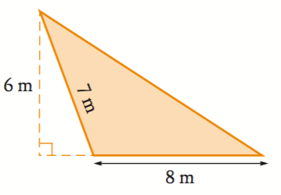
24
7
30
Topic: Area of a Triangle
Date
EQ – How do we calculate the area of a triangle?
Example
Solution
Write the rule for the area of a triangle
Substitute the values for b and h
Evaluate
Area = ½ (b x h)
A = ½ (8 x 6)
A = ½ (48)
A = 24m²

Slide 7
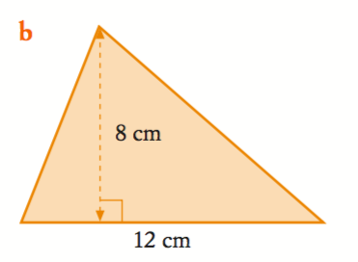
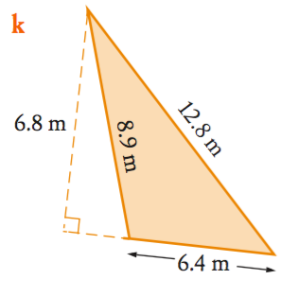
Examples
Area = ½ (b x h)
A = ½ (12 x 8)
A = ½ (96)
A = 48cm²
Area = ½ (b x h)
A = ½ (6.4 x 6.8)
A = ½ (43.52)
A = 21.76m²
Notes:
• Give students the opportunity to practise with teacher guidance
• Provide immediate and specific feedback with knowledge of results

Slide 8
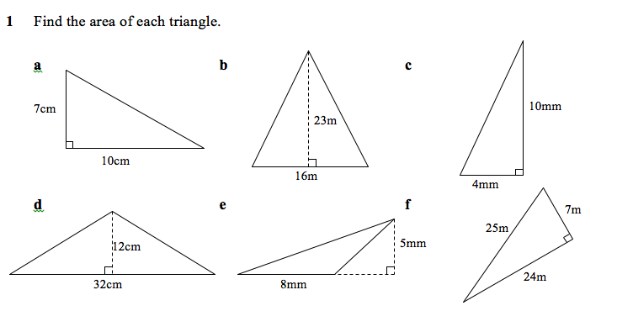
Task
Then page 20-21 in the textbook
Notes:
• Practise the skill
• Encouragement

Slide 9
Summary
Area = ½ (b x h)
Solution
Write the rule for the area of a triangle
Substitute the values for b and h
Evaluate
Notes:
• Teacher summarizes key points of lesson
• Students summarize what they have learned
• Summarize why lesson is important
•Connect to future learning

